Slide 1


Capabilities of HTML5
What can you do with HTML5?

Slide 2
Agenda
Main Features JavaScript
Online/Offline: Application Cache, Client-side Storage
Client-side Storage: Web Storage, Database Storage, File Access
Web Sockets
Web Workers

Slide 3
What is not HTML5
SVG: It’s at least ten years old.
CSS3: It’s…CSS.
Geolocation: Just not HTML5
Client Storage: It was at the beginning, but was separated from the spec, because it was becoming too complicated. It now has its own specification.
Web Sockets: Again, was exported to its own specification.

Slide 4
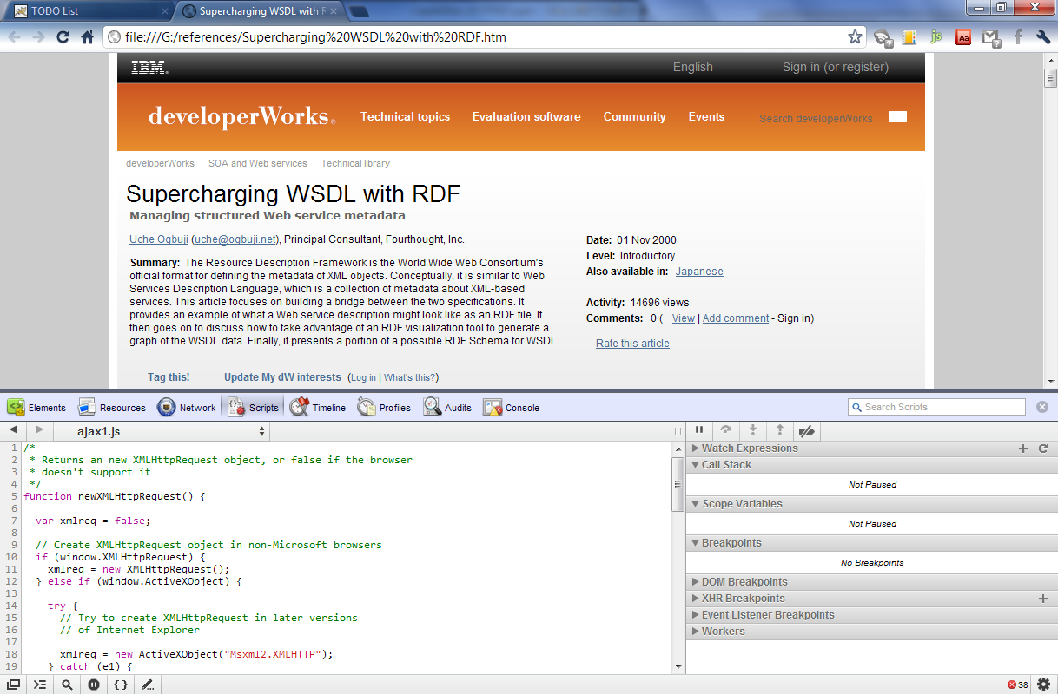
Our Tool

Slide 5
Main Features JavaScript
JS is now more powerful

Slide 6
New Selectors
New ways to retrieve elements of the DOM
Finding elements by class
getElementsByClassName
Finding elements by CSS syntax
querySelector
querySelectorAll

Slide 7
Element.classList
We use the classList property to manage the CSS classes of the element.

Slide 8
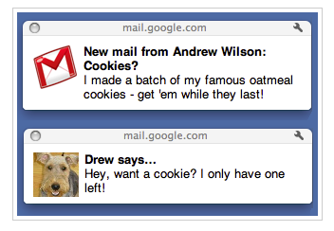
Notifications

Slide 9
Geolocation
Static Position
Track Position

Slide 10
Online/Offline
Application Cache
Client-side Storage
Web Storage
File Access
Database Storage

Slide 11

Application Cache
<html manifest="cache.appcache">
CACHE MANIFEST # version 1.0.0 CACHE: /html5/src/style.css /html5/src/background.png /html5/src/index.html NETWORK: *
FALLBACK:
/images/ images/offline.gif
/*.html /offline.html
The new HTML5 API offers a way to detect if the app is online and handle the situation

Slide 12
Client-side Storage
Client-side Storage
Web Storage
DB Storage
FileSystem API
Local
Session
Web SQL
Indexed DB
Sync API
Async API

Slide 13
Web Storage
Session
Web Storage
Local

Slide 14
DB Storage
DB Storage
Web SQL
Indexed DB

Slide 15
File Access
Sync
Async

Slide 16
File Access
Temporary
Persistent

Slide 17
File System Content
Root
DirectoryEntry
FileEntry
FileEntry
DirectoryEntry
FileEntry
FileEntry
getDirectory
getfile
createReader
remove
createWriter
file

Slide 18

Web Sockets

Slide 19

Web Workers

Slide 20
Conclusions
HTML5 provides capabilities that can make our apps very powerful: fast, collaborative, interactive and responsive even in offline environments.
If the apps we develop require these attributes, we know that we can achieve them using HTML5.

Slide 21

Sample code location
https://github.com/paolocarrasco/HTML5-TODO-List

